Slide 1
Object-oriented programming (oop) concept in python
By krish Modasiya
Date : 2025-04-18

Slide 2
Keys in oops concept
Class
object
Polymorphism
Abstraction
Encapsulation
Inheritance

Slide 3
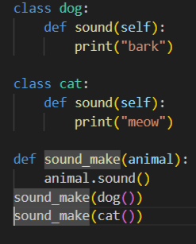
Class and object
● The statements inside a class definition will usually be function definitions but other statements are also allowed
● When a class definition is entered, a new namespace is created, and used as
the local scope—thus, all assignments to local variables go into this new
namespace.
● In particular, function definitions bind the name of the new function here.

Slide 4
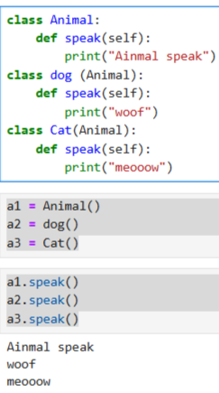
Polymorphism
Poly : mean many
Morphism : mean form or shape
Polymorphism code method is there is a parent class and there children class are class the parent class
See there is in left a code of polymorphism and the animal class is a parent class and the dog and cat are children class

Slide 5
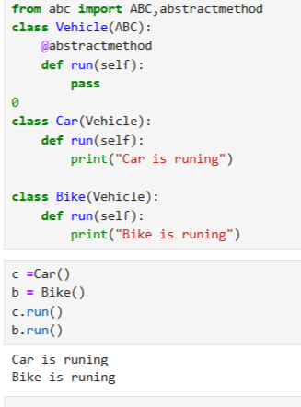
Abstraction
Abstraction is like only use main fuction and the other function are goes in to abstraction it’s use @abstractionmethod
Ex:-
The code in right is abstraction code and see the vehicle class we don’t call we start from car this is abstraction

Slide 6
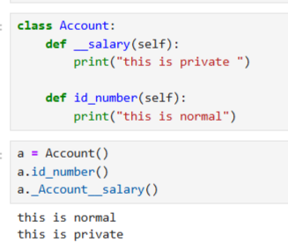
Encapsulation
Encapsulation is a method that don’t show private code the private code is write (_name) and this is private code we can not see the output of private code
Ex:-
Encapsulation code is in right there is function of salary is private so we can not see that and to see the private code so we enter class object name and than private function name

Slide 7
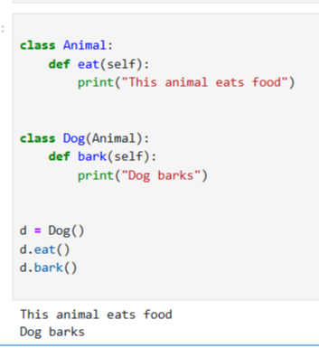
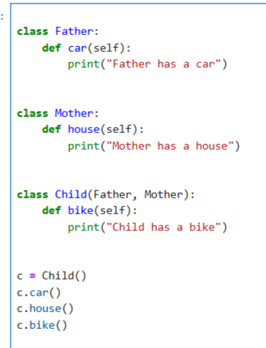
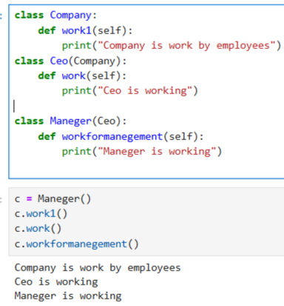
Inheritance
Inheritance example
Multiple Inheritance
There 3 type of Inheritance in python
1. Inheritance
2.Multiple Inheritance
3.Multilevel Inheritance
Multilevel Inheritance
Inheritance:- there is 1 parents class and a children class in Inheritance
Multiple Inheritance:- there is 2 parent class
-> and a children class in multiple Inheritance
Multilevel Inheritance:-there is a grand parent class -> than parent class -> than child class

